Slide 1

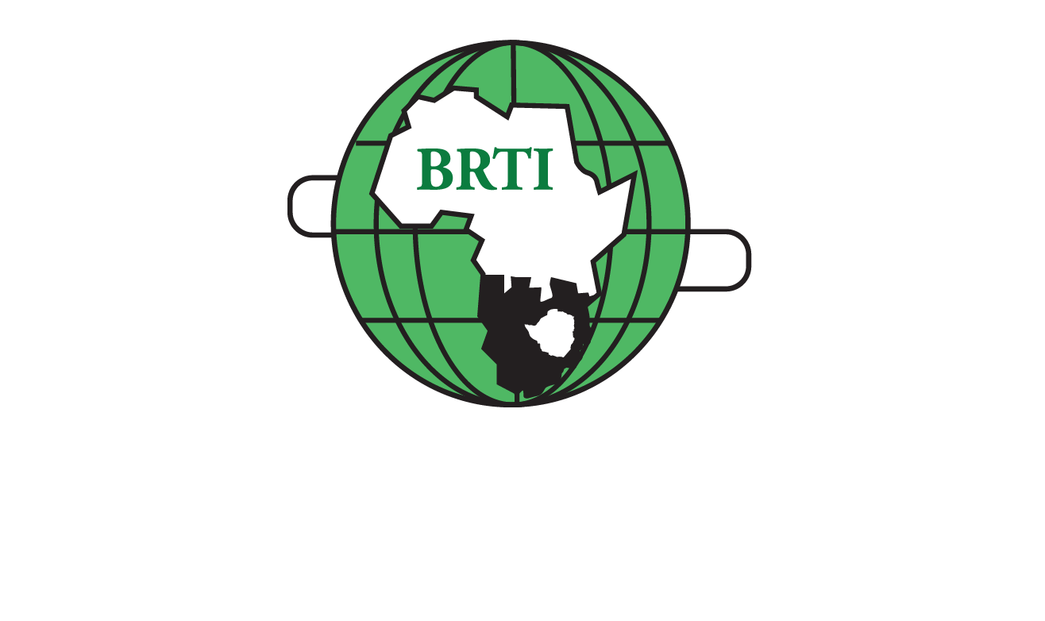

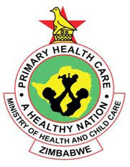

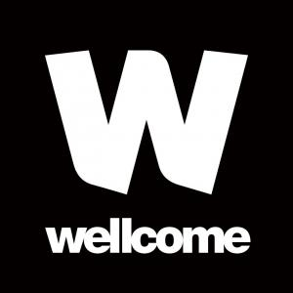
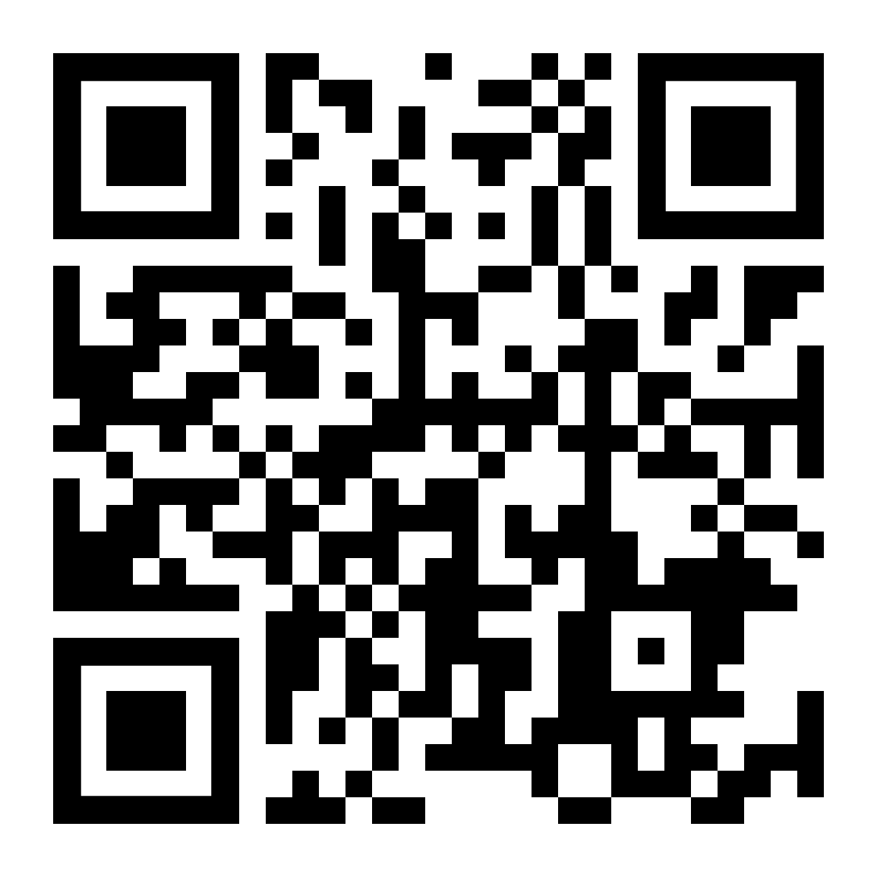
Community based HIV testing and treatment is feasible and yields high level of viral load suppression
E Dauya¹, C Dziva Chikwari^{1,2}, T Bandason¹, A Patel², S Bernays^{2,3}, K Kranzer^{1,2},C Mackworth-Young^{1,2}, C V Mavodza¹, O Mugurungi⁴, V Simms^{1,2}, M Tembo^{1,2}, R Hayes ², R A Ferrand^{1,2}
¹ The Health Research Unit Zimbabwe, Biomedical Research and Training Institute, Harare, Zimbabwe ² London School of Hygiene & Tropical Medicine, London, UK
³ University of Sydney, Sydney, Australia ⁴AIDS and TB Unit, Ministry of Health and Child Care, Harare, Zimbabwe
Background
Youth living with HIV (YLWH) have disproportionately poor virological outcomes.
Community-based HIV and sexual & reproductive health (SRH) services, delivered by teams specifically trained in youth friendliness can result in good outcomes across the HIV care cascade.
Methods
A cluster randomized trial was conducted across 3 provinces in Zimbabwe, each randomized 4:4 to control (existing, largely facility-based, services) or to intervention clusters (total 24 clusters).
The intervention included weekly integrated HIV & SRH services in the community (CHIEDZA) which were delivered to intervention cluster residents aged 16-24 years.
Newly HIV-diagnosed youth could access antiretroviral therapy (ART) through CHIEDZA or at health facilities. Youth in care already could opt to switch to CHIEDZA.
Those who were newly diagnosed were offered viral load testing at 6 months and those who received treatment somewhere else could access viral load testing at any time if they had not had a viral load in the past 6 months.
Results and key findings
36,991 youths accessed CHIEDZA of whom 84% had ≥1 HIV test.
377 YLWH (89% female) were newly diagnosed with HIV
88% of those newly diagnosed were linked to care at CHIEDZA and 96% of them started ART.
Viral load suppression among newly diagnosed YLWH accessing care at CHIEDZA was 90%.
Our study provides evidence that provision of differentiated services for young people in the community is feasible across the whole HIV care cascade
Conclusions
Uptake of HIV testing was high, but yield of new HIV diagnoses was lower than expected.
Community-based testing and treatment is feasible and yields high levels of viral load suppression, and comparable to that among YLWH accessing care in facility-based settings.
Twitter: @ThruZim
www.thruzim.org

